Slide 1
Presentation by Professor Mustafizur Rahman Executive Director CPD, Bangladesh New Delhi: April 30, 2015
Dissemination and Advocacy Meeting
Trade and Knowledge Sharing in HYV Rice Seeds
Scope for Agricultural Cooperation between Bangladesh and India
Areas and Scope for Agricultural Cooperation

Slide 2
Contents
Section I: Newly Emerging Factors
Section II: Prospective Areas of Cooperation
Section III: Challenges to be Addressed

Slide 3
Section I: Newly Emerging Factors
According to the Global Hunger Index, over the last two decades performance of Bangladesh and India in terms of GHI was the best in South Asia. However, many challenges need to be addressed because of the newly emerging factors. Hence the overriding need for deepening Bangladesh-India bilateral cooperation in Agriculture.

Slide 4
Section I: Newly Emerging Factors
Apart from the traditional factors, new ones are driving the cause of deepening Bangladesh-India bilateral cooperation in agriculture related areas:
Trapped in technological frontier, and the need for graduation into new technological frontier
Increasing price volatility in agricultural commodities and the fallouts
The increasing need for shared water management
Climatological factors, land diversion and the need for new agro-practices
Negotiations on Agriculture in the WTO and the needs of marginal farmers
DF-QF MA offer by India and emerging trends in trade in agricultural items
Agricultural cooperation as means of implementation of the SDGs (rights-based approach hunger and food security, poverty alleviation and extreme poverty)
Need for agricultural diversification and commercialization
The WTO decision on public food stockholding
Institutional deficits inspite of increasing endeavours

Slide 5
Section II: Prospective Areas of Cooperation
Levels of Interventions
Policy Level
Institutional, Sector-wide Level
Micro-project Level
Learning from others, Lessons for us
EU-China Cooperation for an Agricultural Quality Policy
Cooperating in the field of organic agriculture:
Cooperation in organic farming as regards mutual recognition in organic agriculture
Recognition of each other's organic laws and regulations and assessment of each other's system enabling an improved market access for organic products for both Parties
Establishing regular contacts and communication concerning respective legislation, technical standards, procedures and controls in the field of organic agriculture and agro-practices

Slide 6
Section II: Prospective Areas of Cooperation
Quality Policy through Geographical Indications Agreement
EU and China to pursue a common quality policy in the field of agriculture. Products of both countries will be helped to project a high quality and high value image in each other's territory. This would help promote the interests of both consumers and exporters
Arriving at a meaningful Geographical Indications Agreement in order to protect products from both parties
Raising awareness of consumers
Encouraging a healthy lifestyle through consumption of agro-products: Areas of action to include food quality and food safety, through development of new food quality schemes.
Promotion campaigns to publicise health related issues in consuming agro-products

Slide 7
Section II: Prospective Areas of Cooperation
Triangulation Through FAO support: China and Africa
Chinese Experts -
have helped popularise 31 practical techniques in Nigeria and achieved 42 major results in cooperation with the local counterparts
have facilitated transfer of 45 practical techniques and achieved 14 major results in cooperation with local counterparts in Nigeria
have demonstrated the advantages of high-yielding cultivation techniques in Sierra Leone which have helped a three-fold rise in the yield of local rice

Slide 8
Section II: Prospective Areas of Cooperation
FAO and SSC
South-South Cooperation (SSC): mutual sharing and exchange of development solutions - knowledge, experiences and good practices, policies, technology and resources - between and among countries in the global South.
facilitating exchange and sharing of development solutions, providing practical guidance and support to ensure high quality knowledge sharing (short-, medium- and long-term exchanges, learning routes, study tours and training);
fostering knowledge management and networks, connecting South-South solution providers with seekers (supply and demand), scaling up knowledge sharing and enhancing two-way learning among a wide range of southern actors;
facilitating upstream policy support, including policy dialogues and knowledge sharing among policy-makers
fostering an enabling environment, mobilizing broader partnerships and resources and raising the visibility of the value of SSC.

Slide 9
Section II: Prospective Areas of Cooperation
Concrete Modalities to Advance Cooperation
Effective bilateral cooperation for agricultural development in would call for:
Establishment of working bodies and networks
Detailed work programmes
Series of agreements on specific issues
Regular monitoring and evaluation system
Leveraging existing organizations such as SAARC Agriculture Centre towards more effective bilateral cooperation
Establishment of Regional Institutes (designate existing institutes with bilateral mandates)
Agricultural Development Strategy should be implemented through the triangulation of public-private-civil society partnership

Slide 10
Section II: Prospective Areas of Cooperation
A comprehensive SPS Agreement between Bangladesh and India to deal with sanitary and phytosanitary issues through standardization, harmonization, recognition of mutual standards, certification and laboratory tests to remove current bottlenecks in bilateral trade countries
Development of infrastructure at LCS to promote bilateral trade in agriculture between Bangladesh and India
Institutional capacity building (both private and public) and training of custom officials on certification standards

Slide 11
Section II: Prospective Areas of Cooperation
Resolving Water Sharing Disputes
Rivers have become a bone of contention in bilateral relations
Increasing drought and flood and increasing water wastage have the potential to create a major water crisis in the region
Collaboration among the South Asian countries is required in the areas of water sharing, building dams, joint hydro-electric projects and watershed management
Need for forward looking, strategic vision

Slide 12
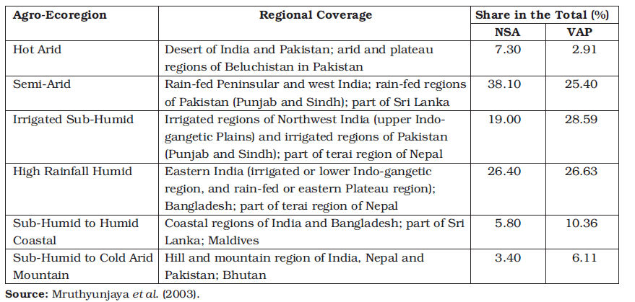
Section III: Challenges to be Addressed
Leveraging Existing SAARC Institutions (SAARC Food Bank; SAARC Seed Bank, SDF etc.)
Shared Water Management through Permanent Institutions
Movement of professionals across borders (SATIS)
Institutional Collaboration on Autonomous basis
Political Dimensions: Agro-Ecoregion versus Political Boundaries
Agro-Ecoregions of South Asia and Their Characteristics

Slide 13
Thank You

