Slide 1
sWAGATAM
Bihar Water Development Society
Sewa Kendra Kurji, P.O. Sadaquat Ashram
Patna – 800 010, BIHAR

Slide 2
‘RISTE’ PROJECT Addressing Barriers to Rice Seeds Trade between India & Bangladesh
Project Leader : Cuts International, Jaipur,
Rajasthan, INDIA.
Partner : Bihar Water Development Society
Patna, BIHAR

Slide 3
S E E D S
“Seeds are ever a positive and creative force. Seeds are germ of life, a beginning and an end, the fruit of yesterday’s harvest and promise of tomorrow’s. Without an ample store of seeds, there can be no ‘National Treasure’, or no future of a nation.”
- Orville L. Freeman
Secretary of Agri., USDA

Slide 4
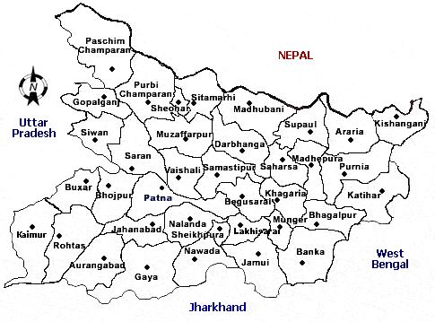
Map of Bihar

Slide 5
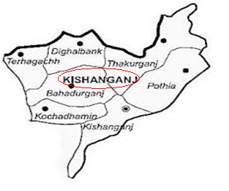
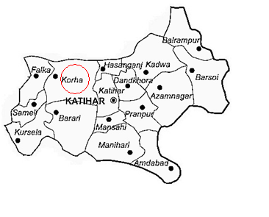
Targeted Districts

Slide 6
Rice seeds Production and distribution Flow map of Bihar
BAU
ICAR
RAU
BS
Research station in other states
BS
BS
BS
NSC
FS
SMF
RAU Farms
BRBN Ltd.
FS
FS
RS
FS
Contract Seed Growers
SVP
CS
Farmers
CS
BRBN Ltd.
Farmers
KVK Campus
CS
CS
RAU Marketing Network
BRBN Sales Centre
Storage
KVK
Authorized Dealers/Distributers

Slide 7
S U R V E Y
District | Block | Panchyat/Village
Purnea | Dagarua | Dagarua
 | Baisi | Baisi (Market)
Katihar | Korha | Bishanpur
Kishanganj | Kishanganj | Chaklaghat , Faringora

Slide 8
STAKEHOLDERS
Seed Grower
Seed Trader
Farmers (Cultivators)
BRBN
Deptt. Of Agriculture, Bihar
KVK, SAUs

Slide 9
VARIETAL PICTURE (HYV)
Upland–Med-Upland : Turanta, Prabhat, Richharia, Dhan
Lakshmi, Sahbhagi, Saket-4
Medium Land : BPT 5204, Rajendra Shweta, Sabourshree,
BR-9, BR-10, BR-11 (BR=Bangla Rice), IR-64,
IR- 4094.
Medium Lowland : Rajendra Mahsuri, MTU 7029, Swarna
Sub-1, Ranjeet, Pankaj, Ganga Godawari
Deep Water : Janaki, Sudha, Vaidehi
Bora Rice : Gautan, Prabhat, Richharia, Dhanlakshmi
HYBRID (Hy) RICE : PHB-71, PRH-10, A-6444

Slide 10
Private Seed Companies (Dealing in Rice Seeds) Working in BIHAR
J.K. Agrigenetics Ltd. | Krishi Dhan
Dhanya Seeds | Nizuveedu
Devgen Seeds | Kaveri Seed
Shri Ram Biogenetics Ltd. | Nath Biogeme Ltd.
BAYER Crop Science Ltd. | Zuari Seed Ltd.
PHI Seeds Ltd. | Rasi Seed Ltd.
Shriram Fertilizer & Chemicals | Victoria Marvel
US Agri Seeds | Syngenta India Ltd.
Ganga Kaveri Seeds | Chand Seeds
Vibha Seeds | Delta Agri Genetics
Manisha | Mahyco Seed Ltd.
Indogulf

Slide 11
State Level workshop (27.11.2013)
Bihar state has potential to fulfill its total rice seed demand, but 90 percent rice seeds are met by private/outside seed companies.
Sale centres should be at accessible place for the rice growers.
Mainstreaming of seed growers with the Krishi Vigyan Kendra for providing technical know-how.
Dissemination of information regarding government schemes especially seed production of rice.

Slide 12
Rapport with the print & electronic media
Print media (5 nos.) publishing (daily) newspaper stationed at Patna were approached and briefed about work of the Project.
Two electronic media who broadcast programme on agriculture were also approached.

Slide 13
Organization of Discussion Seminar
On 7th July 2014, Discussion Seminar on “Rice Seed Trade between India and Bangladesh” was held which was attended by media personnel, Agricultural scientist and the RISTE personnel.
There is possibility of rice seed trade between two countries as rice varieties of India (Bihar) are being grown by Bangladesh and vice-versa.
Mutual visit of rice scientists, govt. officials, will make the things clear.
Training of farmers (seed growers) for quality seed production.

Slide 14
Future Planning
Visit of the targeted areas and interaction with the local stakeholders including Govt. officials of Agriculture, Deptt. (DAO, SAO, BAO, Krishi Samanvyak & Kisan Salahkar)
Visit of the targeted areas just before start of all 3 cropping seasons (Aus, Aman, Boro) of rice to know the rice varieties being sold in the local market and grown the area by the farmers.

Slide 15
Future Planning
More emphasis on boro rice production as rice area is increasing in this season.
Assessment of rice seed availability and the seed replacement rate.
Training of rice seed growers/farmers about quality seed production, seed storage and bagging for marketing and export.

Slide 16
Future Planning
To train the seed growers/farmers for seed certification.
Ensuring locally produced seeds sale/marketing.
To explore possibility of rice (quality) seed export to Bangladesh or bilateral trade between India and Bangladesh.
Advocacy through print & electronic media.
Organization of workshops and seminars at Sewa Kendra, Patna and Krishi Gyan Gosthi, Krishi Mela in the targeted areas.

Slide 17
POTENTIAL ACTIVITIES FOR EXTENSION PERIOD
SWOT (Strength, Weakness, Opportunity, Threat) analysis.
Advocacy .
Training of seed growers about quality seed production.
Organization of Krishi Mela and Krishi Gyan Gosthi in the targeted areas.

Slide 18
Thanks

