Slide 1
INDIA-BANGLADESH–IRRI COLLABORATION ON SEEDS

Slide 2
Few facts
Mega varieties of Bangladesh - BR11, BRRI dhan 28 & BRRI dhan 29 are widely grown in WB, Assam and Tripura
Indian rice varieties covered approx. 21% area in Bangladesh during the wet season of 2013.
Swarna (MTU 7029), although never released in Bangladesh is now the most popular variety in Aman season in Bangladesh (Bashar, person. Commu.).
Using recent technologies like MABB, a improved /new variety can be developed 2 years.

Slide 3
Stress tolerant varieties released
Line/Variety | India | Bangladesh | Nepal
Submergence tolerant
IR05F102 | Swarna-Sub1 (2009) | BRRI dhan-51 (2010) | Swarna-Sub1 (2011)
IR07F290 | 2015? | BRRI dhan-52 (2010)
IR077101 | Samba Mahsuri-Sub1 (2014) | BINA dhan 12 (2013) | S. Mahsuri-Sub1 (2011)
IR09F436 (Ciherang-Sub1) | 2015? | BINA dhan 11 (2013) | 2015?
Drought tolerant
IR74371-46-1-1 |  |  | Sukhadhan-1 (2011)
IR74371-54-1-1 |  |  | Sukhadhan-2 (2011)
IR74371-70-1-1 | Sahbhagi dhan (2010) | BRRI dhan 56 (2011) | Sukhadhan-3 (2011)
IR87707-445-B-B-B | IR64-Sukha1 (2014)
IR87707-446-B-B-B |  |  | Sukha dhan 4 (2014)

Slide 4
Varieties released…..
Line/Variety | India | Bangladesh |  | Nepal
Salt tolerant
 |  |  | BRRI dhan 53 (2010)
 |  |  | BRRI dhan 54 (2010)
 |  |  | BRRI dhan 55 (2012)
IR66946-3R-149-1-1 |  |  | BINA dhan-8 (2010)
 |  |  | BINA dhan 10 (2012)
AS996 |  |  | BRRI dhan-55 (2011)
CSR89-IR8 | CSR 43 (2013)
IR72046-B-R-3-3-3-1 | CR dhan 405 “Luna Sankhi” (2013)
CR Dhan 406 | CR Dhan 406 “Luna Barial” (2013)

Slide 5
Hence there is need for enhanced collaboration between India and Bangladesh to speed up the process of varietal release and dissemination to the farmers and for more effective utilization of resources.

Slide 6
Regional Workshop for Cooperation on Seed Issues
Dhaka
17 February 2013

Slide 7
Participants from India
Shri Ashish Bahuguna Secretary Agriculture
Dr. Swapan Datta, DDG (Crops), ICAR
Dr. Atanu Purkayastha, JS (Seed)
Dr. P.L. Gautam, Former DDG (CS); Chairperson, NBA and PVFRA
Dr. Subarata Biswas, Principal Secretary (Ag), WB
Dr. Bardhan Roy, ex-JD, RRS, Chinsura
Mr. Selvaraj, Dy Commissioner, MoA

Slide 8
Participants from Bangladesh
Begum Matia Chowdhury, Hon’ble Minister of Agriculture
Mr. Monzur Hossain, Secretary to the President; former Secretary, MoA
Mr. S.M. Nazmul Islam, Presently Secretary Agriculture, former Chairman, BADC
Mr. Anwar Faruque, Additional Secretary & DG-Seed Wing
Dr. Wais Kabir, former DG, BARC
DG, BRRI; DG, BINA
Other senior Government officials
Scientists from BRRI & BINA

Slide 9
Participants from IRRI
Dr. Bruce Tolentino, DDG (IC)
Dr. Abdelbagi Ismail, Principal Scientist
Dr. U.S. Singh, Senior Scientist (II), South Asia Regional Coordinator-STRASA
Dr. Timothy Russell, Country Representative
Dr. Zainul Abidin, Senior Scientist
Dr. MA Bari, Project Manager-STRASA

Slide 10
Purpose of workshop
To identify key priority areas for collaboration in seed sector to speed up the process of varietal release & dissemination to benefit farmers

Slide 11
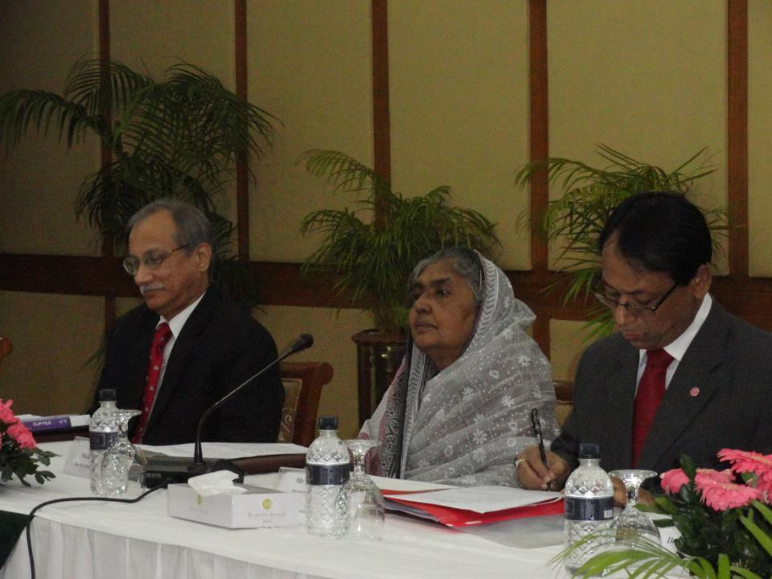
India and Bangladesh: the key players
16-17 Feb 2013

Slide 12
Decisions
Bangladesh and India will pursue the collaboration in respective countries
IRRI will play the role of facilitator
Annual progress review by the committee: JS (seed) & DDG (crops) from India, DG-Seed wing & DG-BRRI from Bangladesh & IRRI SA Coordinator for seed systems
IRRI will organize annual review meeting

Slide 13
Areas identified for collaboration 1. Joint varietal evaluation & release
Joint evaluation of varieties for release in similar agro-climatic conditions, by the respective countries. To start with, this may cover the IRRI lines which are being/will be shared by both India as well as Bangladesh. Simultaneously, efforts would be made to develop a collaborative project involving the three parties to identify and evaluate improved rice breeding lines developed by Indian institutions, Bangladesh institutions and IRRI in both the countries. Collaborative project will address the issues relating to IPR, germplasm exchange etc. Cost for evaluation by national institutions will be borne by the respective countries.

Slide 14
Recommendation
IRRI will work closely with ICAR (Head, Plant Breeding at CRRI and DRR or any other person/ agency decided by ICAR), BRRI (Head, Plant Breeding or any other designated person) and BINA (Head, Plant Breeding or designated person) to develop a collaborative project for joint varietal evaluation and submit the same to Ministry of Agriculture in both the countries for the approval. This project will also consider/ address the IPR issues, if any.

Slide 15
Areas identified for collaboration 2. Acceptance of the evaluation data
Reciprocal recognition and acceptance of the research and evaluation data generated in one country for the varietal release for similar agro-climatic condition in the other country.

Slide 16
Recommendation
This may be started with IRRI developed rice lines which are being evaluated in both the countries. It would be essential for the any line to undergo minimum one year IVT testing through AICRIP. In addition, one year evaluation in AVT 1 of AICRIP or one year multi-location testing in state trials (for state release). Evaluation data of Bangladesh may be considered in lieu of AVT 2 or second year state evaluation for release for similar agro-climatic condition (i.e. acceptance of Bangladesh data for varietal release in WB, Assam and Odisha and Nepal data for UP and Bihar).

Slide 17
Areas identified for collaboration
3. For varieties released in neighbouring country
Reduction of the evaluation time for a variety released in one country by the other country to speed up the varietal release process.
Recommendation
Any variety released in neighbouring country, may be released in India after one year of IVT under ACRIP along with one year of either state evaluation or AVT1 through AICRIP. There is no need of AVT2 or second year state varietal trial.

Slide 18
Areas identified for collaboration 4. Acceptance of PVS data
Recognition of the farmers’ participatory varietal selection (FPVS) data, generated by the scientists, as primary data for the varietal release to accelerate the release process. A joint committee, consisting of experts from IRRI, India and Bangladesh (as nominated by respective Agriculture Secretary and DG, IRRI) will review the issue and suggest any change in the protocols to make them compatible with varietal release system of respective countries.

Slide 19
Recommendation
Farmers participatory varietal selection (PVS) is a very important step, where breeders themselves undertake multi-location evaluation at farmers’ fields with the participation of farmers. This captures farmers’ acceptability and creates the awareness among them about new materials. Although it is not compulsory, many breeders have now started doing PVS before forwarding the proposal for release. There is thus need to encourage it and consider making it compulsory for the rainfed environments, where climatic conditions are highly heterogenous. In order to encourage breeders to adopt PVS, its data may be taken as primary data for varietal release in lieu of AVT2. However, in order to develop a uniform protocol a committee is being proposed which may submit a standard protocol within 30 days:
Dr. RK Singh, ex-IRRI Liaison Scientist and PVS expert as Chairperson
Dr. T. Ram, Principal Scientist, Plant Breeding, DRR. member
Dr. J.N. Reddy, Principal Scientist, Submergence breeder, CRRI member
Dr. US Singh, IRRI

Slide 20
Areas identified for collaboration
5. MABB developed varieties
Simplify the process of evaluation of varieties developed by Marker Assisted Backcross Breeding (MABB). This is necessary as such varieties are developed in the background of local popular varieties. Hence, the new varieties are simply improved version of old popular varieties, retaining all their agronomic and quality traits. India has already taken some steps in this direction. Bangladesh may work in this direction to implement the same after completing the required formalities.
Recommendation
India has already reduced the time for evaluation by one year (by relaxing the evaluation time from three to two years in IVT and AVT 1) for MAS generated materials in the background of popular varieties.

Slide 21
Areas Identified for Collaboration
6. Pre-release promotion
Promote pre-release seed multiplication and demonstration of promising varieties which are in advance stages of release. This will include the varieties identified for release by the State based on data of AICRIP and State trials. In case of Bangladesh this may be after two years of adaptive trials in Bangladesh. This process will generate awareness of these varieties among the farmers and help in the creation of seed demand, and will also ensure the availability of enough breeder seed to move into seed system once these varieties are formally released/notified. This will also encourage public and private sector seed corporations/companies to engage in seed production and promotion in business mode, which is the most sustainable way of promoting a variety and ensuring its faster spread.

Slide 22
Recommendation
Distribution of seed minikits of non-released varieties used to be practice earlier to get the farmers’ feedback. The experience with stress tolerant rice varieties, Swarna-Sub1 and Sahbhagi dhan, showed that pre-release seed multiplication and minikits distribution could be very useful for rapid out scaling of the varieties. Rice lines which have undergone minimum one year of AICRIP evaluation and one year of evaluation in state trials may be promoted through seed minikits/demonstrations to create awareness among farmers. These varieties may be called as research varieties and anticipated amount of TL seed may be multiplied by research institutions/NSC/state seed corporations. NSC/ promoting institution may also multiply larger quantity of nuclear and/or breeder seed which, once a variety is released, may be used for the production of breeder/foundation/certified seed to saturate the entire seed chain.

Slide 23
Areas Identified for collaboration
7. Project on biotechnology
India and Bangladesh will develop programs for collaboration in application of biotechnological tools for development of different products. IRRI will help in identification of such programs. Cost of the projects would be shared by both the countries.
Recommendation
A joint research proposal for the transfer of stress tolerance QTLs to more mega rice varieties from both the countries may be developed jointly by ICAR, BRRI and IRRI and submitted for funding by the national/ international agencies/donors. IRRI may coordinate this activity.

Slide 24
Areas identified for collaboration
8. Exchange of germplasm
The parties recognized that exchange of germplasm including that developed by IRRI is very important issue and there is need to discuss it further by involving other stakeholders and considering the provisions of the relevant legislation.
Recommendation
DAC & ICAR are handing this matter in accordance with the existing legal framework in consultation with different stakeholders. Progress made so far may be noted during the annual review meeting of this protocol.

Slide 25
Identified for collaboration
9. Review workshop
IRRI will facilitate the organization of workshops every alternate year involving senior officials and policy makers of India and Bangladesh to share their experiences in field of rice research and development and to identify new areas for the collaboration.
Recommendation
IRRI will organize annual review workshop before end of May 2014. Representatives from Nepal, Pakistan, Sri Lanka, Myanmar and Bhutan governments may be invited to explore the possibility of extending this cooperation to other countries in the region. FAO, SAARC and relevant CG Centres may also be invited

Slide 26
Areas Identified for collaboration
10. Private sector & TL seed
Recognizing that new breeding tools are accelerating the range of materials that will be suitable for many different rice growing environments, the state managed seed production and distribution capacity of the two countries may require supplementation by the private sector. Thus, the two countries agree to develop compatible policies and regulations regarding “truthfully labelled” rice seed.
Recommendation
There is need to promote private seed companies and public sector seed corporations to undertake the TL seed multiplication of new varieties. In order to work out the modalities and create a level playing field for both public & private sectors, a committee may be constituted for suitable recommendations.

Slide 27
Areas Identified for Collaboration
11. Harmonization of seed system
Efforts will be made for the harmonization of seed laws, legislation and protocols of two countries to make the collaboration in seed sector more effective. IRRI will facilitate the process.
Recommendation
IRRI is preparing document on comparative analysis of the seed systems in South Asia for consideration by the Ministry of Agriculture in India and Bangladesh for the harmonization of the seed system.

Slide 28
Follow-up action
Agenda | Action to be taken by | Time frame
1. Joint varietal evaluation & release | IRRI | 30.04.2014
2. Acceptance of the evaluation data |  | 30.04.2014
3. For varieties released in neighbouring country |  | 31.03.2014
4. Acceptance of FPVS data |  | 31.03.2014
5. MABB varieties
6. Pre-release promotion |  | 31.03.2014
7. Joint research proposal on biotechnology | IRRI | 30.08.2014
8. Exchange of germplasm
9. Progress review workshop | IRRI? | 30.05.2014
10. Private sector & TL seed |  | 30.05.2014
11. Harmonization of seed system | IRRI? | 30.08.2014

Slide 29
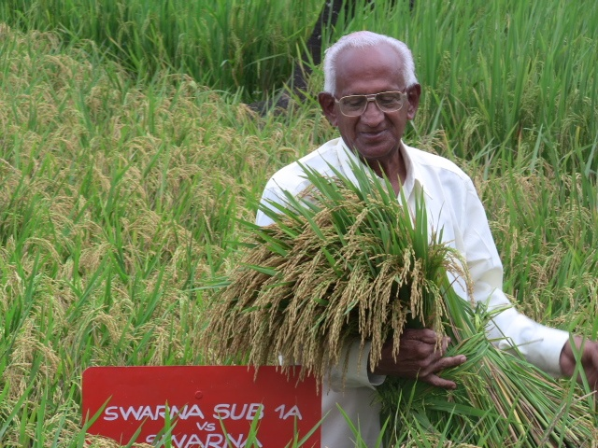
THANK YOU

