Slide 1
Sub-Regional Trans-Boundary Cooperation towards Food Security
Media Conference
Sustainable Development Investment Portfolio in South Asia
Organised by CUTS International
20 December, 2015, (11 a.m. to 2 p.m) at Agartala PRESS CLUB, Tripura
With the support from Agartala Press Club

Slide 2
Recent positive developments in Eastern South Asia and North East India
Bangladesh-Bhutan-India-Nepal (BBIN) showing high political will for integration
As many as 22 agreements, MoUs and protocols were agreed and signed during Indian Prime Minister’s visit to Dhaka in June 2015. This includes:
Protocol for Exchange of Instrument of Ratification for Land Boundary Agreement
Agreement on Coastal Shipping between India and Bangladesh
Agreement on Kolkata-Dhaka- Agartala Bus Service
Protocol on Inland Waterways Transit and Trade (PIWTT)
MoU between India and Bangladesh on Use of Chittagong and Mongla Ports for Movement of Goods to and from India
Bilateral Cooperation Agreement between Bureau of Indian Standard (BIS) and Bangladesh Standard and Testing Institute (BSTI)

Slide 3
Recent positive developments in Eastern South Asia and North East India
BBIN Motor Vehicle Agreement was inked by the four countries and protocols almost finalised
India-Bangladesh already proposed furthering the existing energy cooperation
Bangladesh agreed to give India exclusive access to two SEZs in Bheramara and Mongla
Kaladan Multi-Modal Transit Transport Project expected to be completed in 2016
Rs 20,000-crore road projects declared by Indian Government, besides developing inland waterways, in the North-East
Four Border Haats operating, many more planned

Slide 4
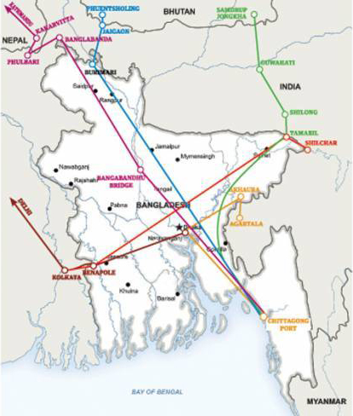
BBIN Proposed Routes

Slide 5
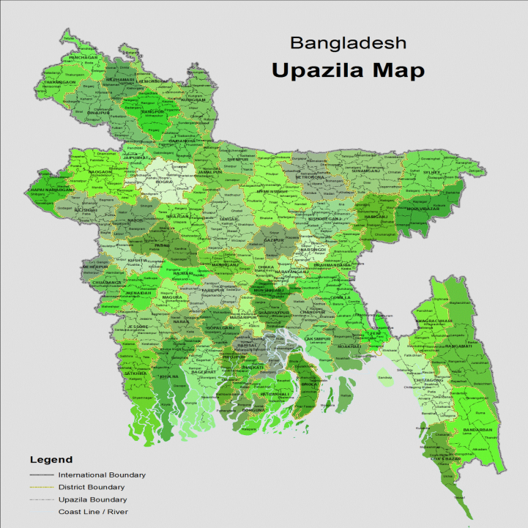
SEZs allocated to India

Slide 6
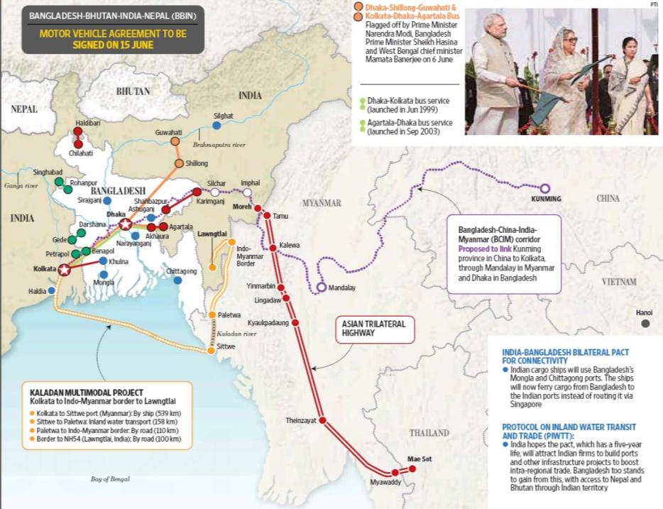
Larger Connectivity Initiatives

Slide 7
Tripura
Surrounded by Bangladesh, 84% of border
Similarities in language, culture, climate and food habits
High possible gains from cross border value chains (particularly agri-products)

Slide 8
Tripura & Food Security
While average outside procurement for paddy is 1 lakh metric tons, the same for vegetables was 0.13 lakh metric tons in 2012-13 and for Potato was roughly 1.3 lakh metric tons in 2013-14
With increasing population, this requirement is expected to increase in future with possible impact on food security
Tripura shares 84% border with Bangladesh and is very similar in terms of climate, culture, language and most importantly food habits.
Tripura and North Eastern states in general stand to gain from greater trans-boundary cooperation with Bangladesh and can have immediate gains from cross border agricultural value chains.
2014-2015 |  |  | 2015-2016 |  |  | 2016-2017
Ppn. (Lakh) | Reqmnt. (Lakh Metric Tons) |  | Ppn. | Reqmnt. |  | Ppn. | Reqmnt.
 | Veg | Fruits |  | Veg | Fruits |  | Veg | Fruits
38.352 | 6.999 | 1.399 | 38.916 | 7.102 | 1.420 | 39.488 | 7.206 | 1.441

Slide 9
Tripura & International Trade
Tripura’s import from Bangladesh was INR 357 crores, (stone chips, cement, plastics products and fish) in 2014-15. The state can gain further from import of agricultural and other allied products. (data source: Department of Industries & Commerce, Government of Tripura)
The export figure is comparatively low and includes seasonal fruits, cardboard, leather, etc. The state has potential to enhance its exports in rubber, betel leaf, bay leaf, etc.

Slide 10
Border Haats – A Success Story
A very good initiative by the state are the two existing Border Haats with Bangladesh operating at Srinagar and Kamalasagar.
The haats are doing really well in terms of generating local economic benefits as well as access to new and better products.
Collective business at the borer haats have crossed INR 2 crores so far for the current year.
CUTS’s study of the haats also revealed that the haats stand as live examples of how trans-boundary cooperation can lead to immediate economic gains, higher access and better people-to-people connect.

Slide 11
Hurdles
Regulatory Barriers, (e.g. quarantine regulations) and lack of cooperation between national authorities
Non-harmonised standards and non-recognition of certificates
Lack of adequate testing facilities
Institutional and Stakeholder Capacity
Local political ownership of initiatives
Infrastructure

Slide 12
Way outs
Promote higher cooperation between state, national and trans-boundary regulatory authorities
Promote harmonisation and mutual recognition of standards and certifications
Facilitate a more robust trans-boundary agricultural value chain
Build capacities of stakeholders and institutions
Create ownership of developmental projects
Upgrade infrastructure
Promote Border Haats

Slide 13
Role of Media
Enhance capacity on trade led development issues, the hurdles and possible solutions
Create space for public and policy level discourses on these issues, particularly for trans-boundary cooperation in the Tripura-Bangladesh perspective
Create public and political consensus on the need to promote pro-people and pro-cooperation policy and practice change

Slide 14
We Welcome Your Opinions and Deliberations

Slide 15
Thank You
Prithviraj Nath
Policy Analyst & Head
Cuts Calcutta Resource Centre
+919830481370
pn@cuts.org

