Slide 1
REGIONAL COOPERATION IN SEED SECTOR in SA

Slide 2
Few facts
Mega varieties of Bangladesh - BR11, BRRI dhan 28 & BRRI dhan 29 are widely grown in WB, Assam and Tripura
Indian rice varieties covered approx. 21% area in Bangladesh during the wet season of 2013.
Swarna (MTU 7029), although never released in Bangladesh, is most popular variety in Aman season in Bangladesh.
Indian rice varieties, Swarna, Sarju 52 and Samba Mahsuri are popular in Nepal terai
THESE COUNTRIES SHARE BORDER AND SIMILAR AGROECOLOGIES

Slide 3
FEW FACTS
All three countries : Bangladesh, India and Nepal has got well established rice research and varietal development program & seed system
RICE VARIEITAL EVULATION AND RELEASE SYSTEM IN BANGLADESH, INDIA AND NEPAL ARE AT PAR

Slide 4
There is need for regional cooperation to speed up the process of varietal release and out scaling for the benefit of farmers and for more efficient utilization of resources.

Slide 5
Regional Workshop for Cooperation on Seed Issues
Dhaka
17 February 2013

Slide 6
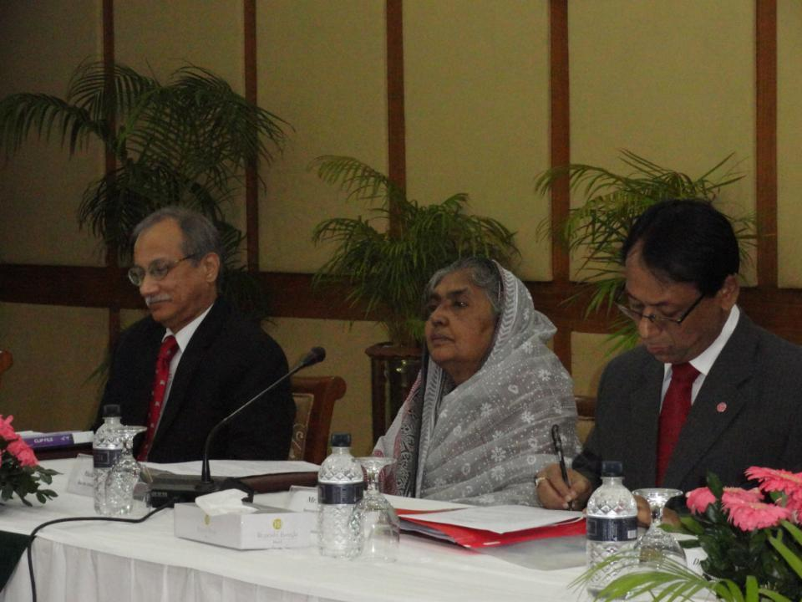
India and Bangladesh: the key players
16-17 Feb 2013

Slide 7
Bangladesh-India-IRRI collaboration : Areas identified (Protocol signed on 17 February 2013)
Joint varietal evaluation and release
Reciprocal recognition of evaluation data for varietal release
Reducing time for the evaluation of varieties released in neighbouring countries for similar agro-ecologies
Reducing time for evaluation for MAS generated varieties
Acceptance of PVS data as primary data for varietal release
Pre-release seed multiplication & promotion
Encouraging private sector by providing level playing field.
Harmonization of seed system
Germplasm exchange

Slide 8
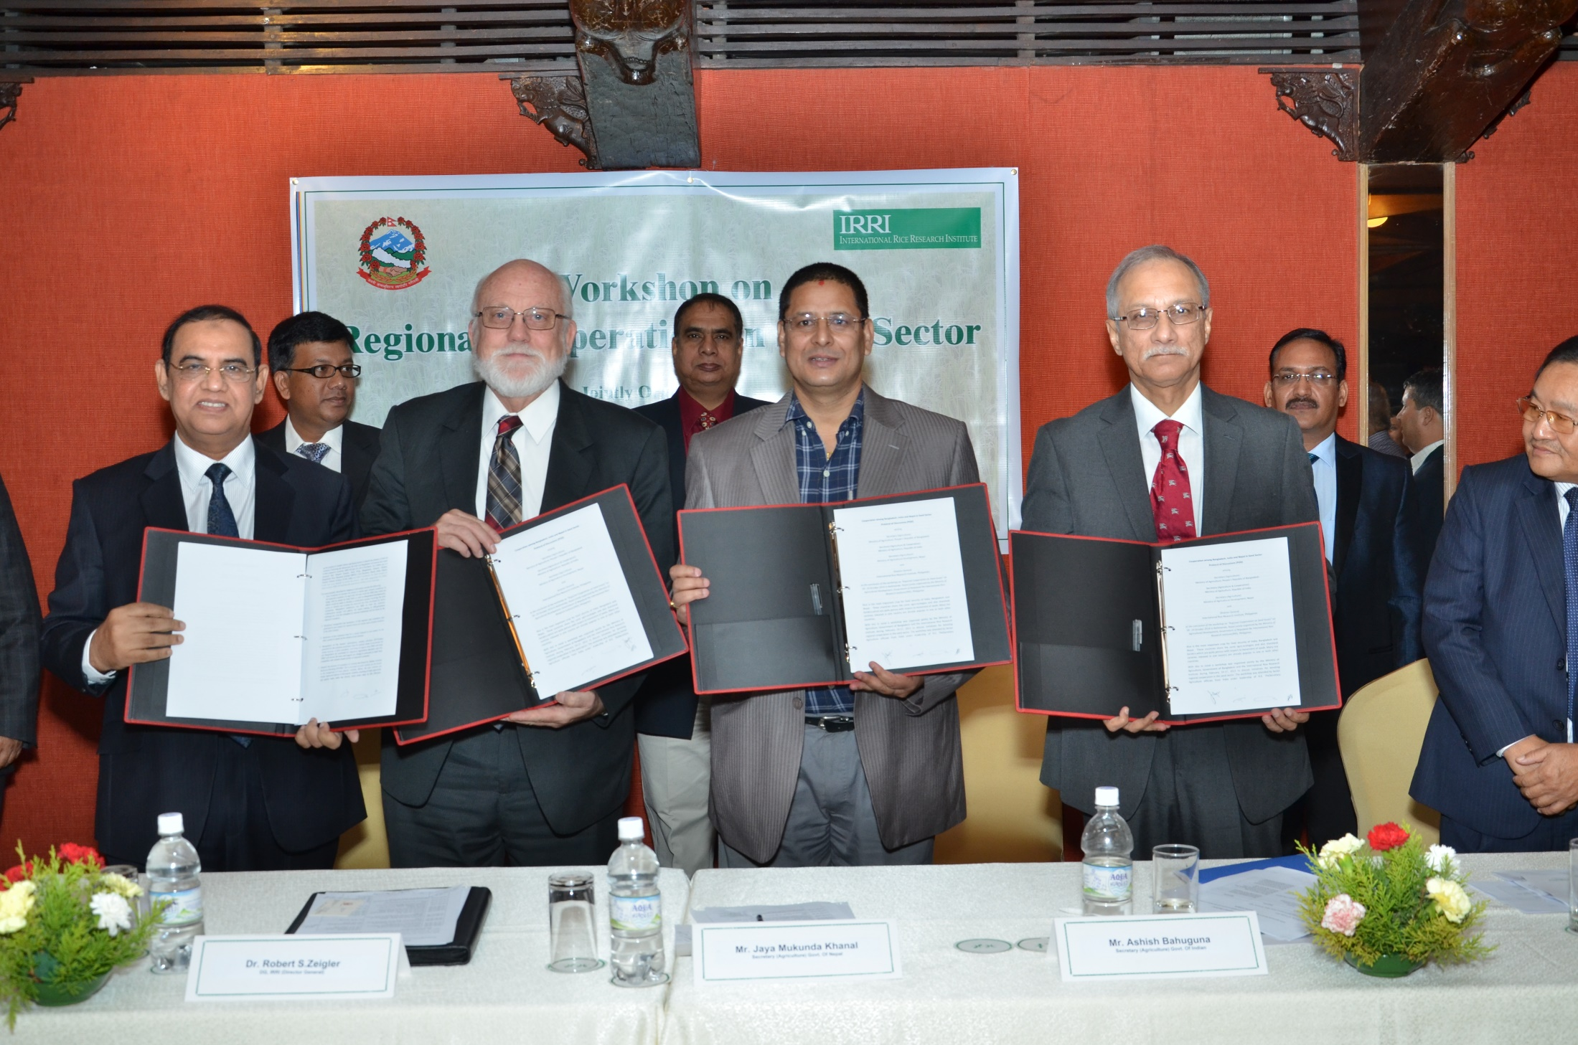
18 October 2014

Slide 9
Bangladesh, India, Nepal and IRRI collaboration (protocol signed on 18 October 2014)
* Protocol signed by Bangladesh, India and IRRI extended to Nepal
* Three countries agreed to share the evaluation data and varieties released in their respective countries for release and commercialization in the other two countries

Slide 10
Implementation of agreement
India has already notified following varieties released in Bangladesh for cultivation in WB, Assam and Tripura
BINA dhan 8, BINA dhan 10, BINA dhan 11 & BINA dhan 12
India has notified following varieties released in Nepal for UP and Bihar
Sukha dhan 5 & Sukha dhan 6

Slide 11
The Ministry of Agriculture in India allocated 30% rice budget under its two mega schemes NFSM (National Food Security Mission) and BGREI (Bringing Green Revolution to Eartern India) for the year 2015 for promotion of stress tolerant rice varieties (mainly Swarna-Sub1, Sahbhagi dhan). (Exact allocation will be known first week of April; budget allocation for next financial year- but expected to be > $ 100 million).

